Slide 1
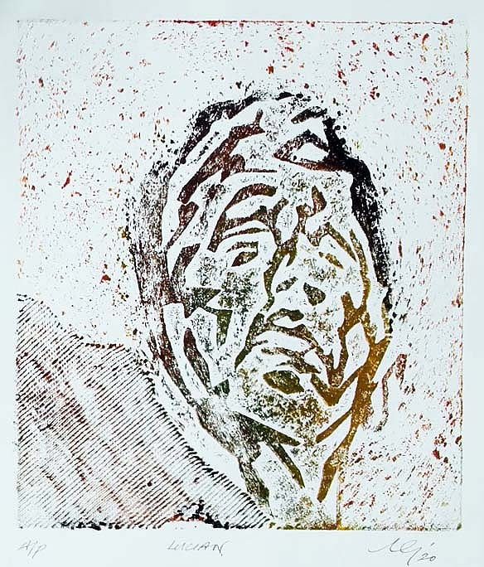
Collagraphy
Portraits

Slide 2
Collagraphy
Collagraphy was introduced in 1955 by Glen Alps and is a printmaking process in which materials are applied to a rigid substrate. The word is derived from the Greek word koll or kolla, meaning glue, and graph, meaning the activity of drawing. (Glue Drawing)
Collagraph is a basic method of printmaking using a board with collaged materials glued onto it to form a relief surface with a variety of textures.
A very creative and experimental form of printmaking, collagraph prints can be made with many different materials, including cardboard, wool, string, fabric, leaves, masking tape and more.

Slide 3
Process
Glue a cut stencil of a portrait, face or cartoon character onto greyboard.
The printmaking term for the greyboard surface is called a “plate.”
(Remember, prints will be made in reverse)
Some ideas for materials to use:
- Cut or rip shapes from cardboard,
- Textured paper,
- Fabric, felt, burlap or canvas,
- Craft foam shapes,
- Wool or string,
- Leaves, seeds, small twigs and other organic materials,
- Straw,
- Gesso to create a variety of brush strokes and paint-like textures,
Sand,
Sawdust,
Rice.

Slide 4
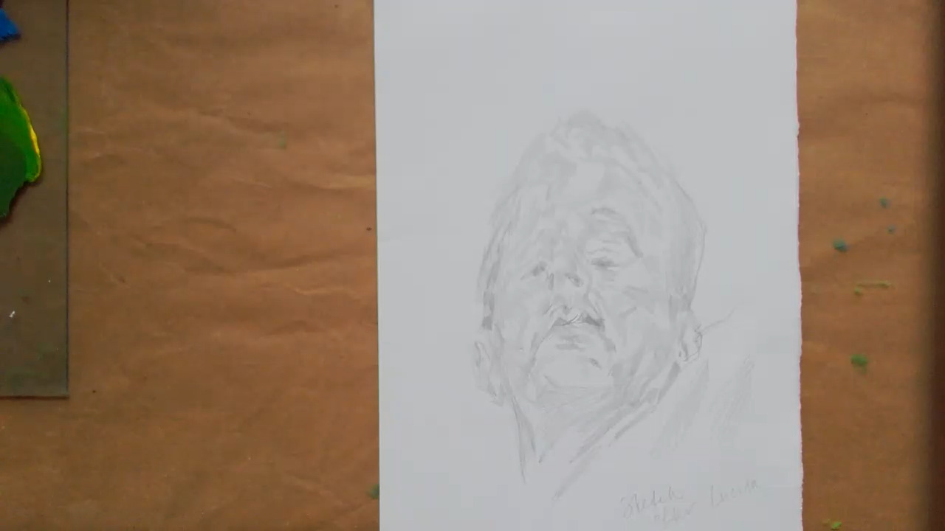
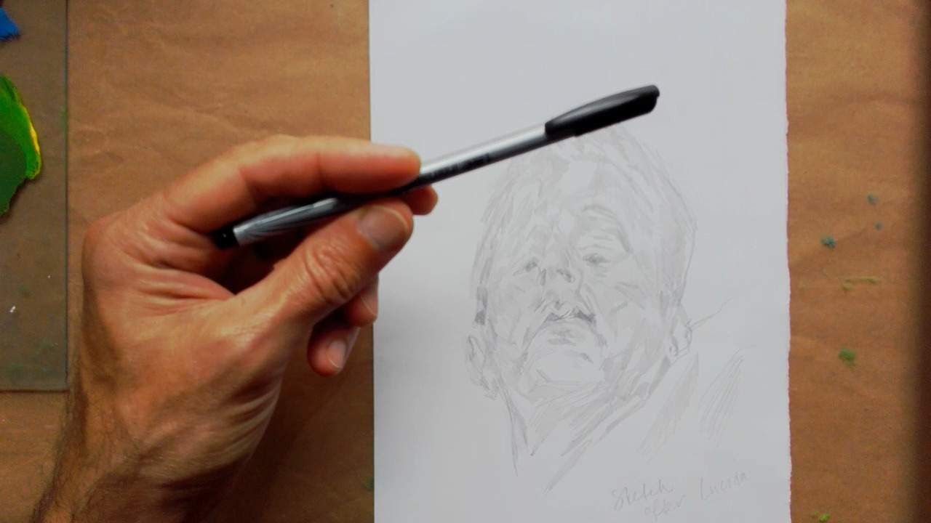
Drawing
1: Begin with a pencil drawing of a face. This can be a real person, an imaginary person or cartoon character.
Choose a felt pen to draw over your pencil lines, simplifying the drawing to create a stencil of your image.

Slide 5
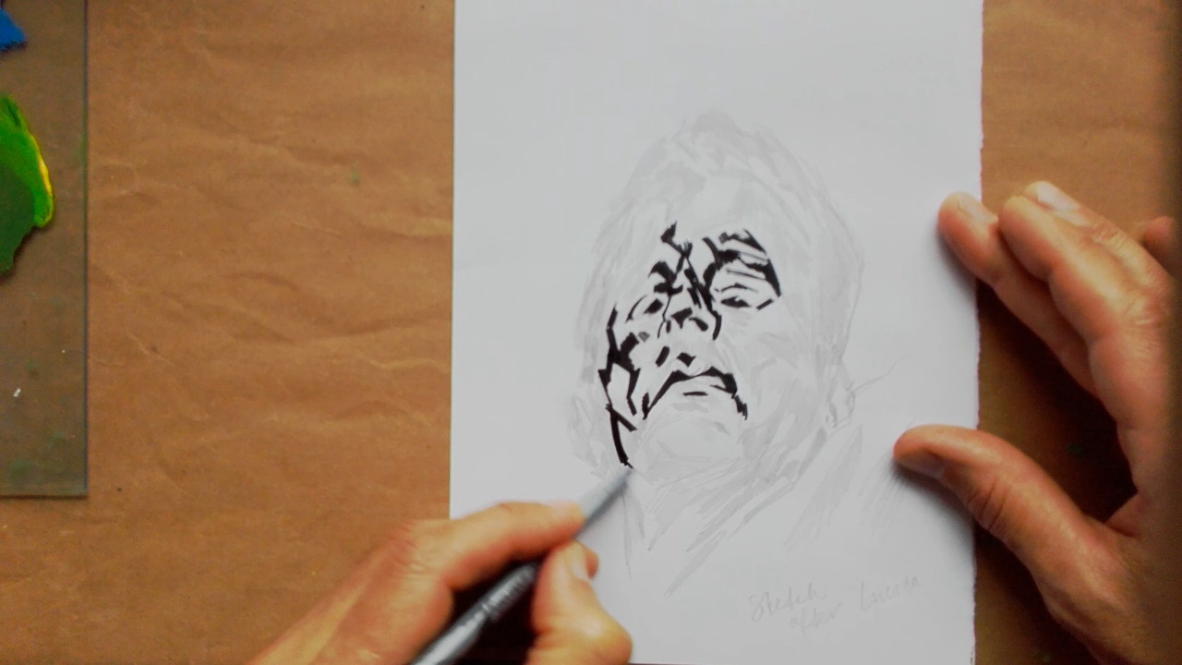
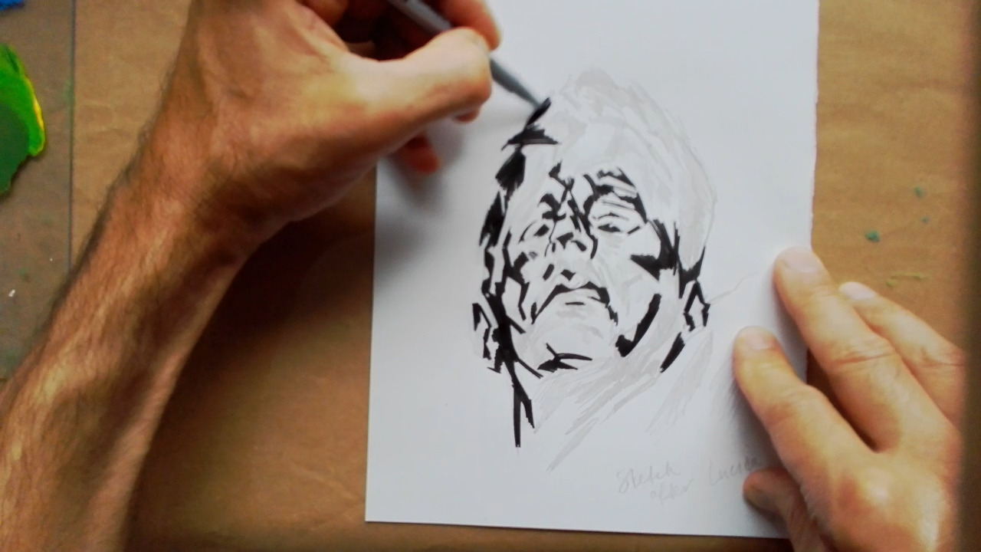
Inking your drawing
2: Draw over the pencil lines to create a simplified line drawing.
This will allow you to cut your stencil more easily, cutting away the white areas and leaving the black lines, which will be your stencil.

Slide 6
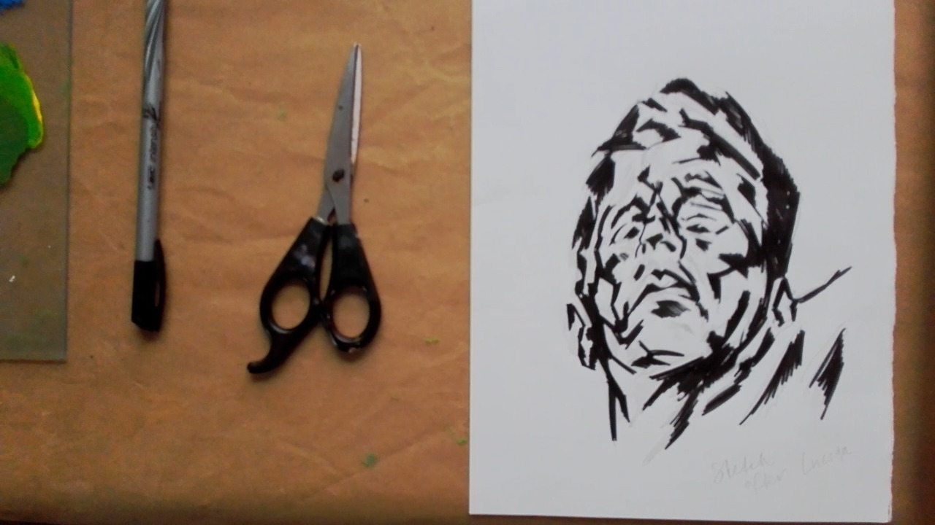
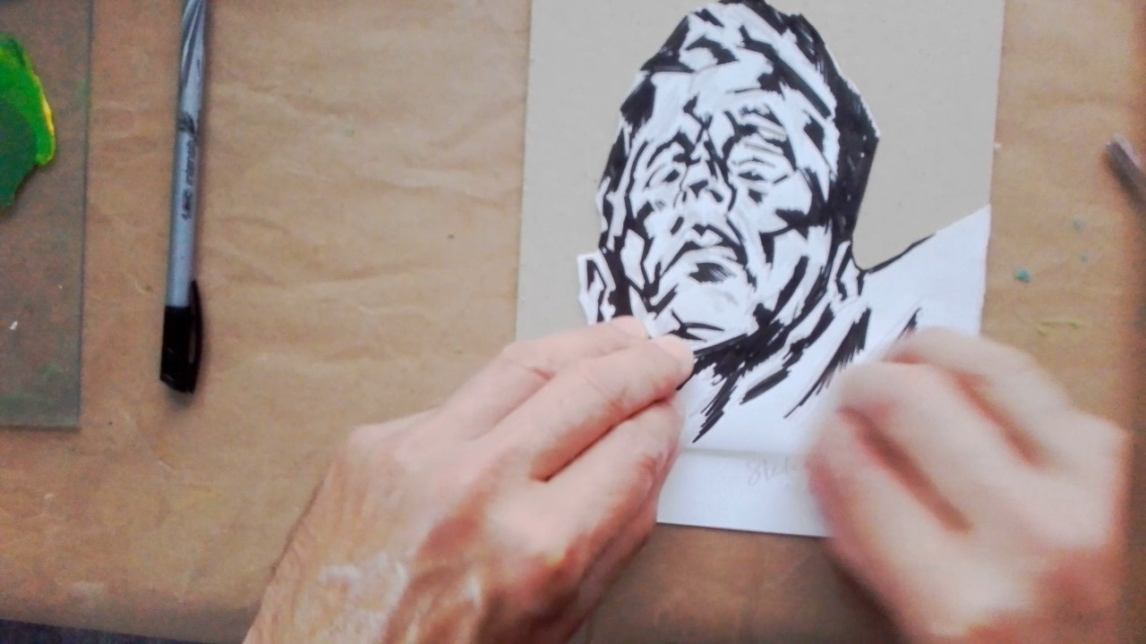
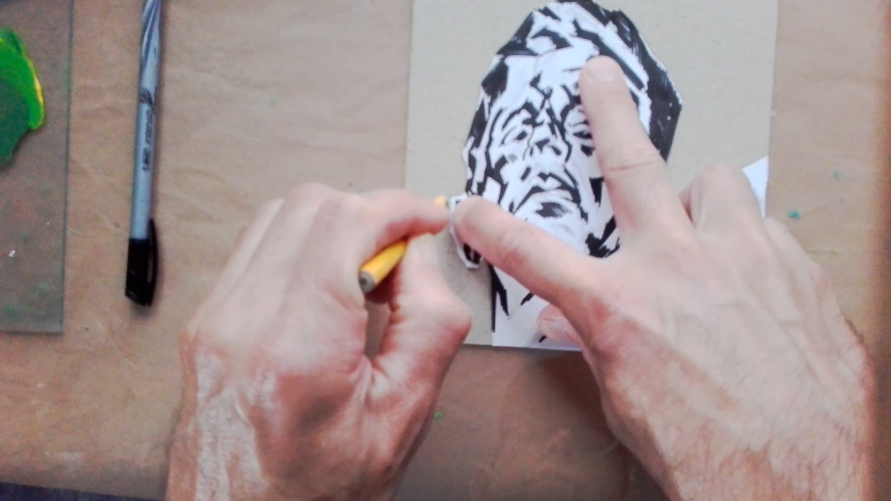
Stencil
3: Cut away the back ground, so you are only left with the figure.
4: Place the figure onto the greyboard to ensure it fits in the space.
5: Draw an outline around your figure so you know where to place the glue for the stencil pieces.

Slide 7
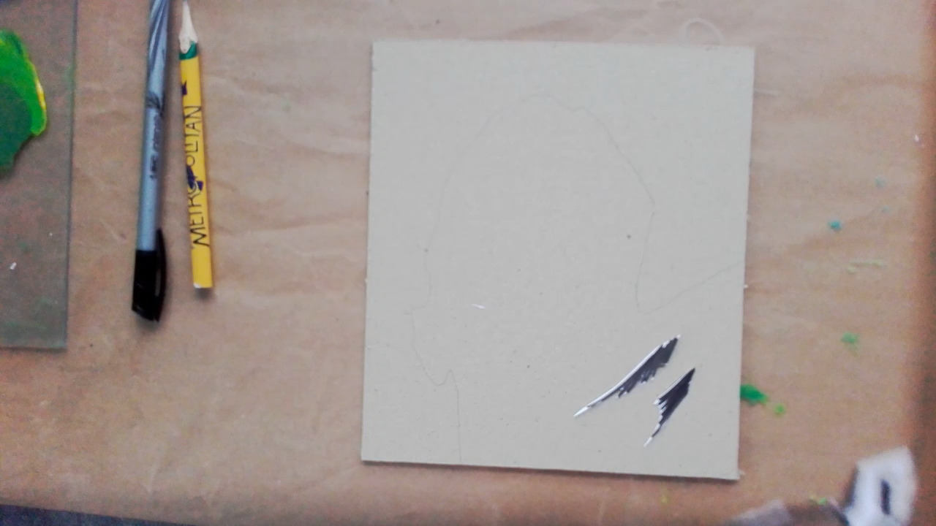
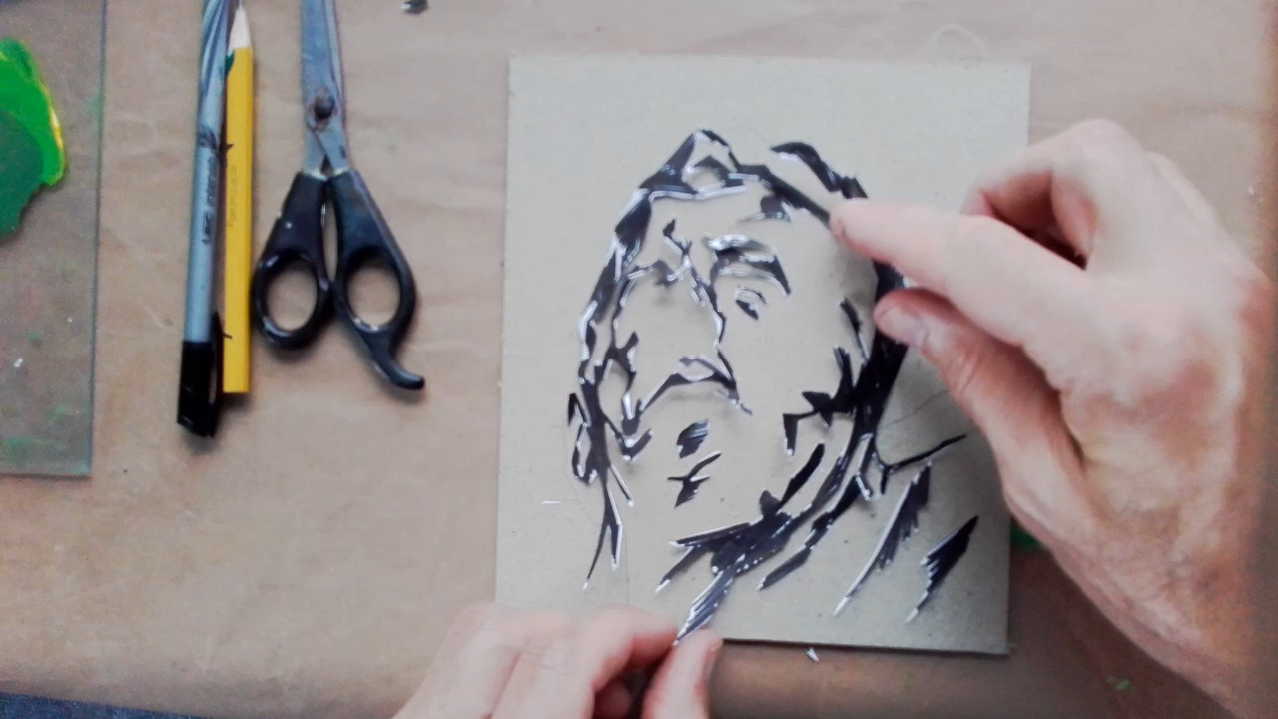
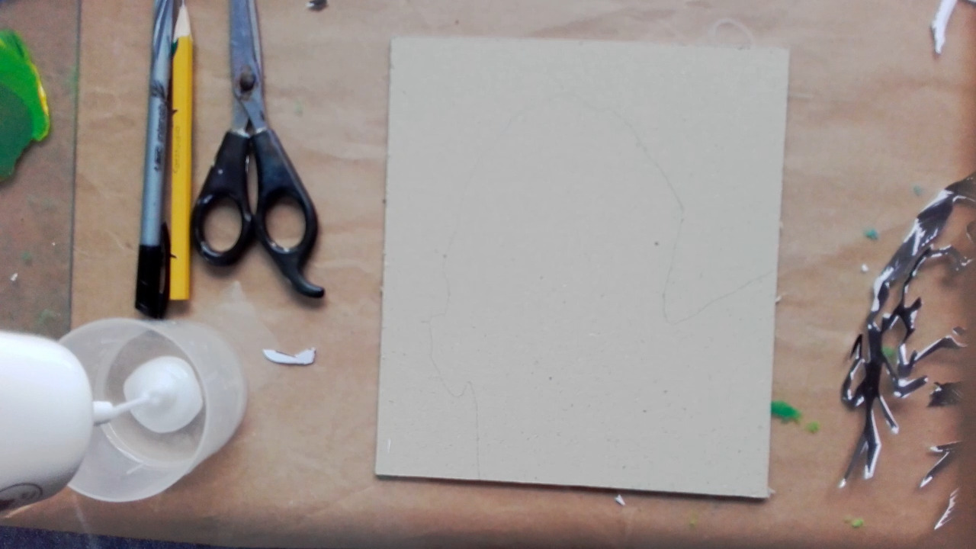
Stencil
6: Cut out all the areas drawn with the felt pen and re-arrange on top of your plate.
7: When ready to glue, remove the pieces and fill the area of the figure with glue, inside the outline you drew earlier.

Slide 8
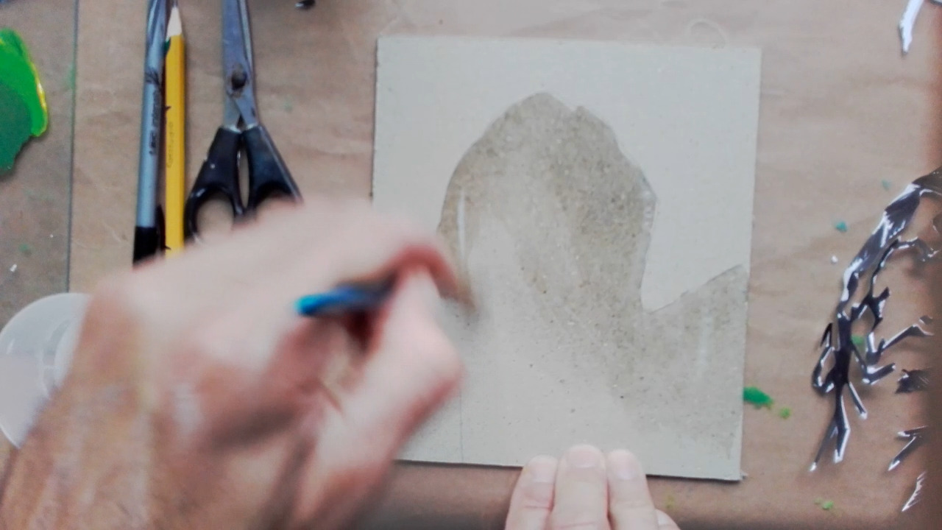
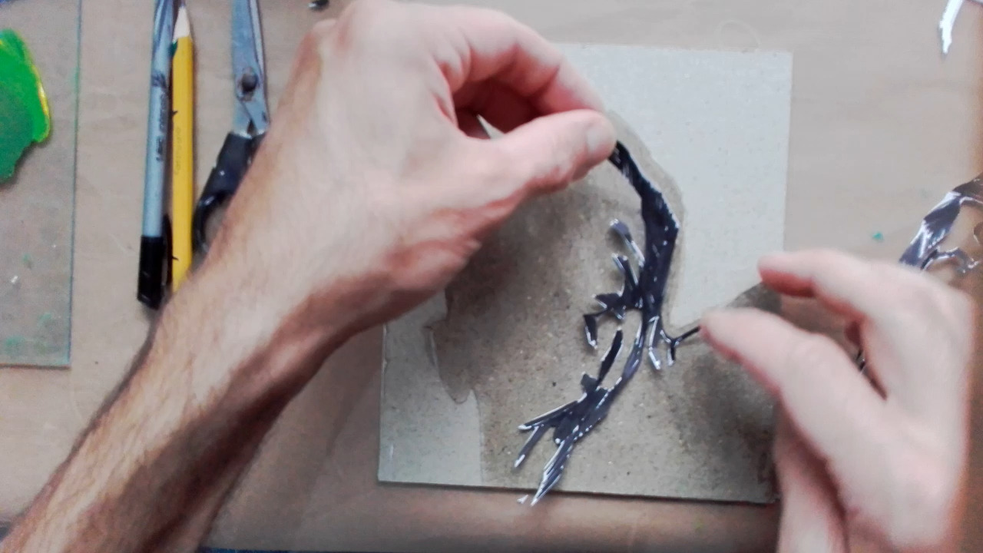
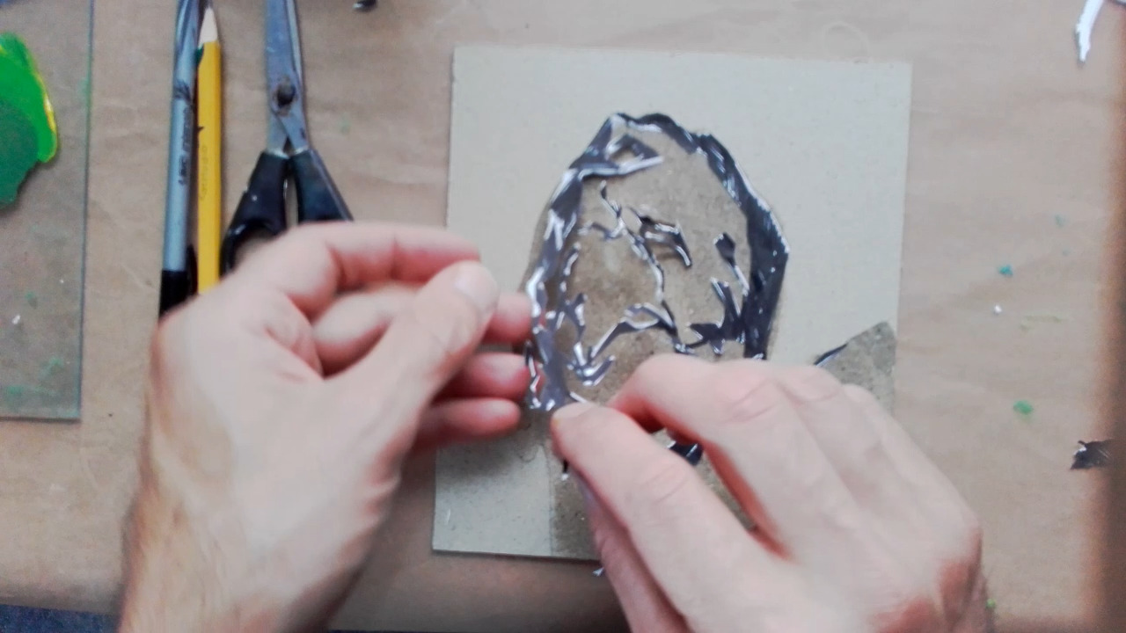
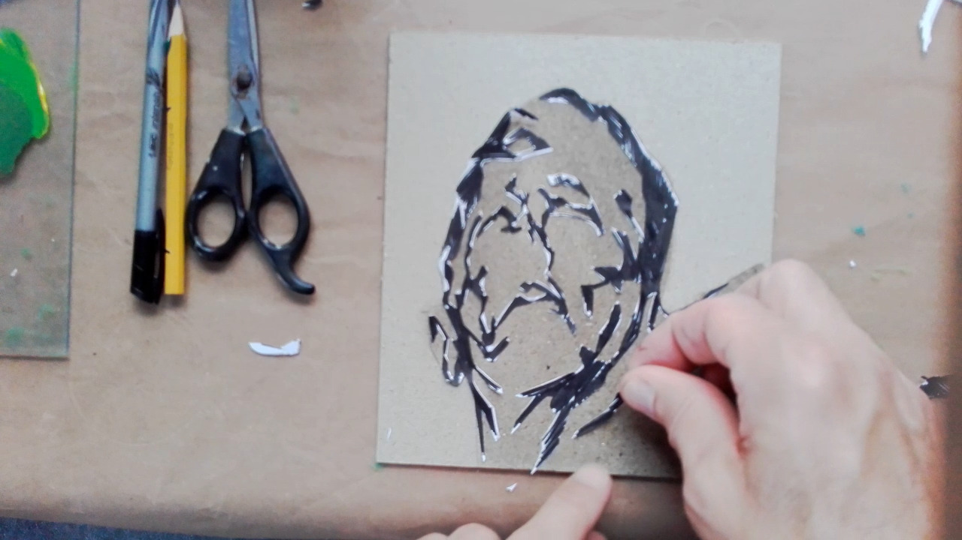
Glue the stencil

Slide 9
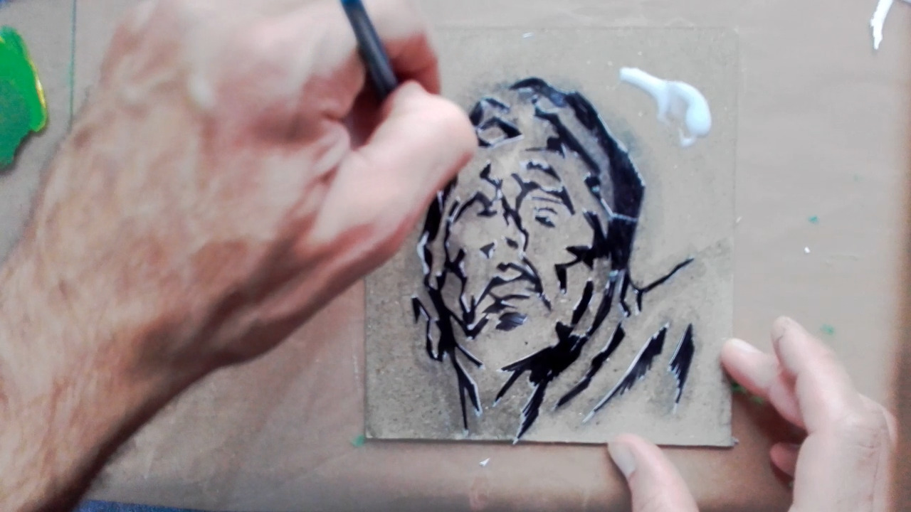
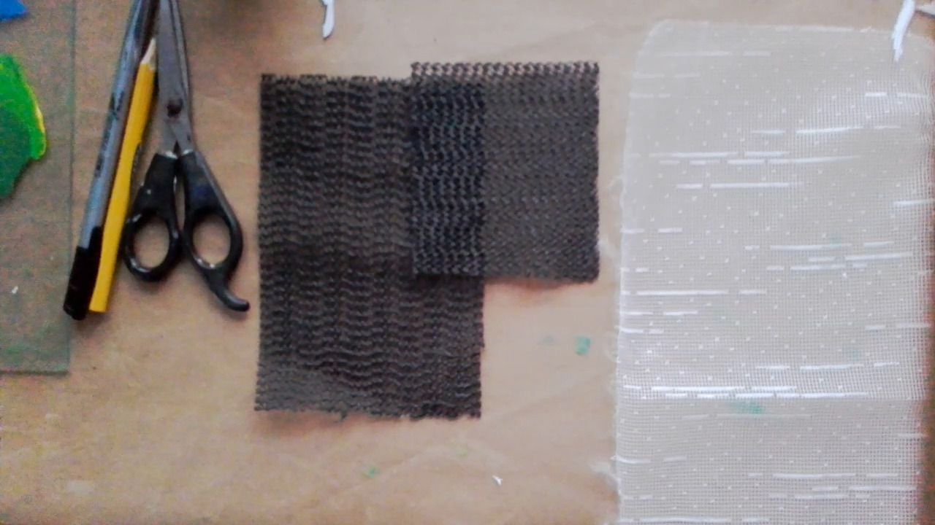
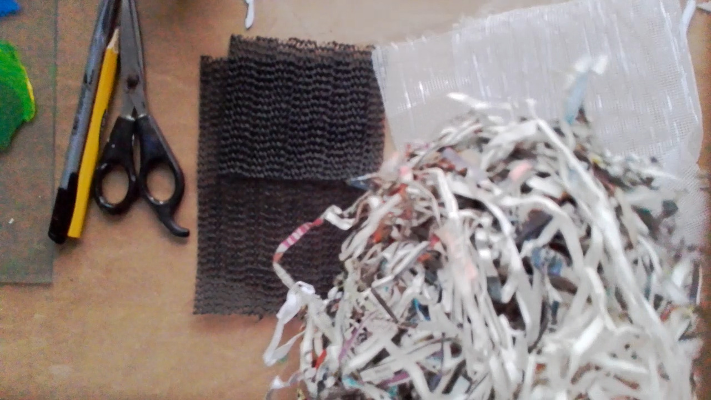
Cover with PVA glue ready for textures...
8: Cover the background area around the figure with PVA, preparing for some texture.
9: You can use a variety of materials for textures. Here I have some non-slip material, an old net curtain and some shredded paper. I also have sawdust.

Slide 10
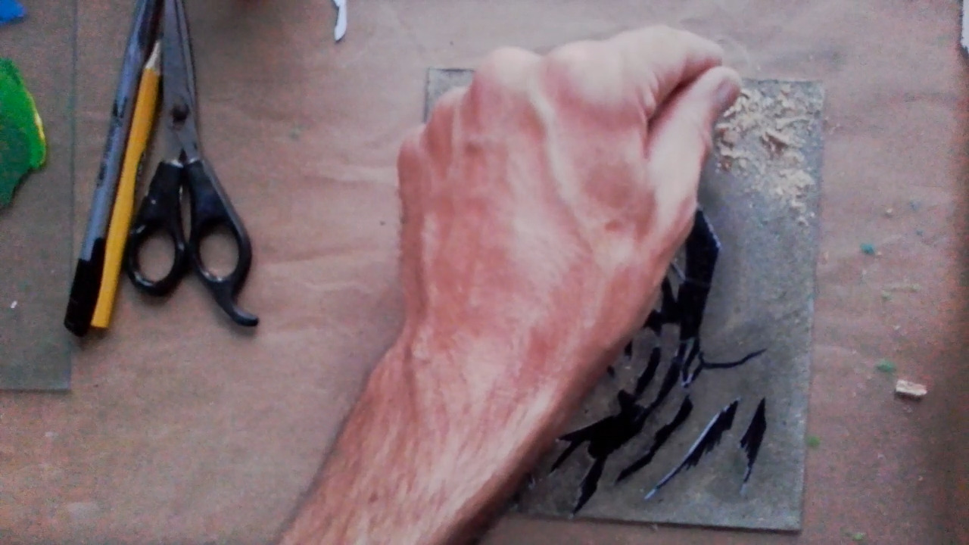
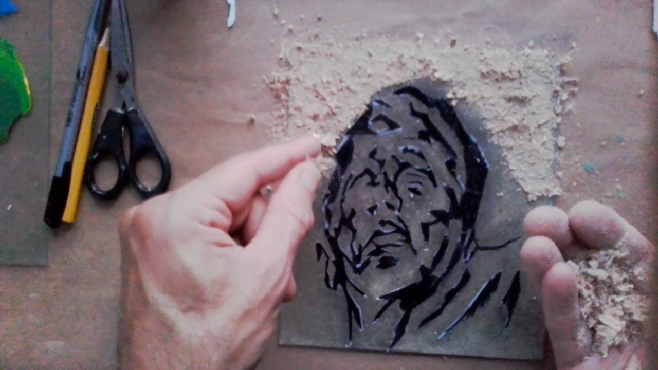
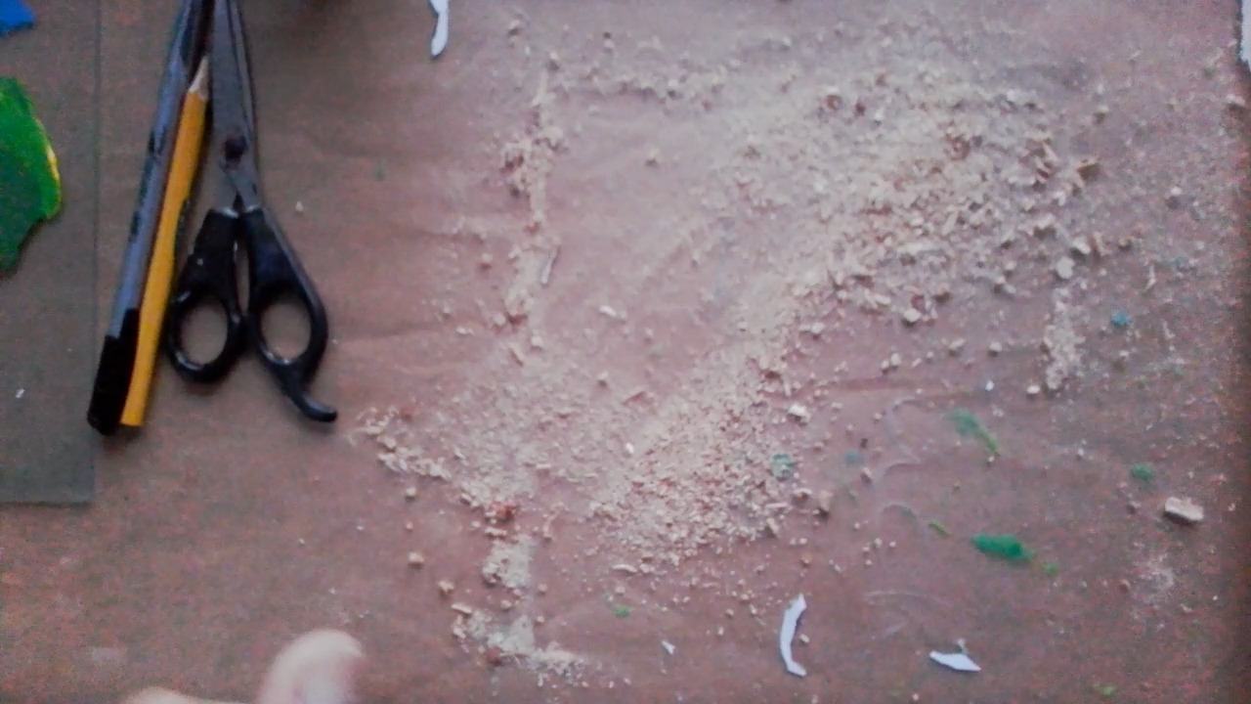
Textures
10: I sprinkle sawdust over the background covered in glue, like glitter. When covered I shake off the excess and brush back into the bag.

Slide 11
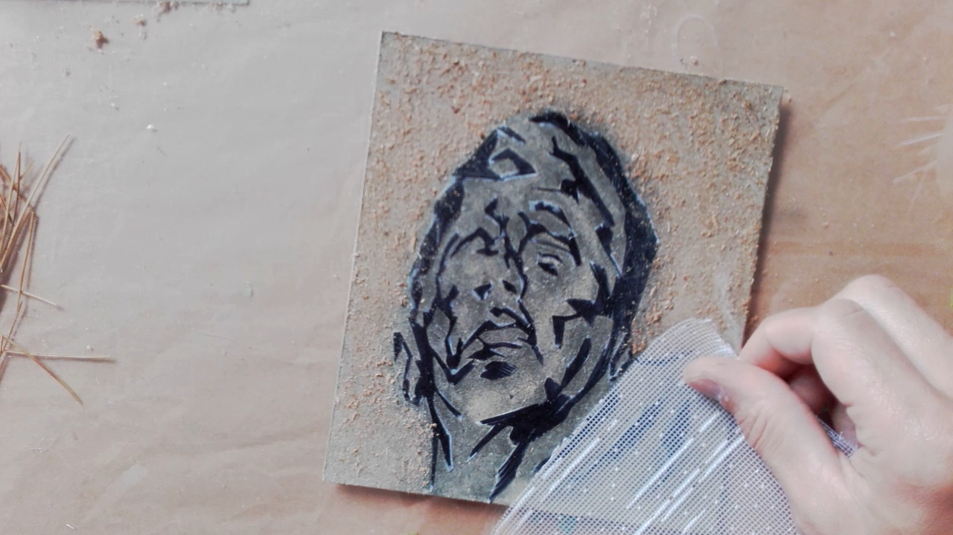
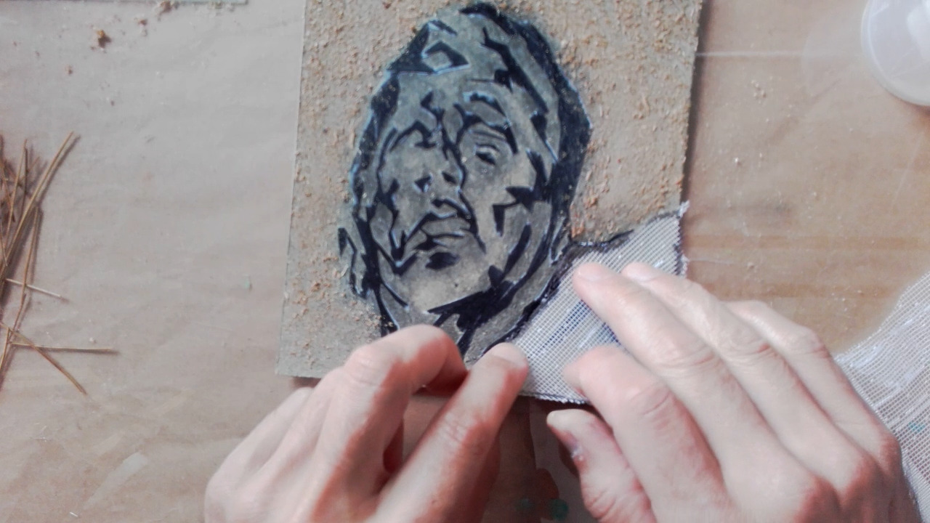
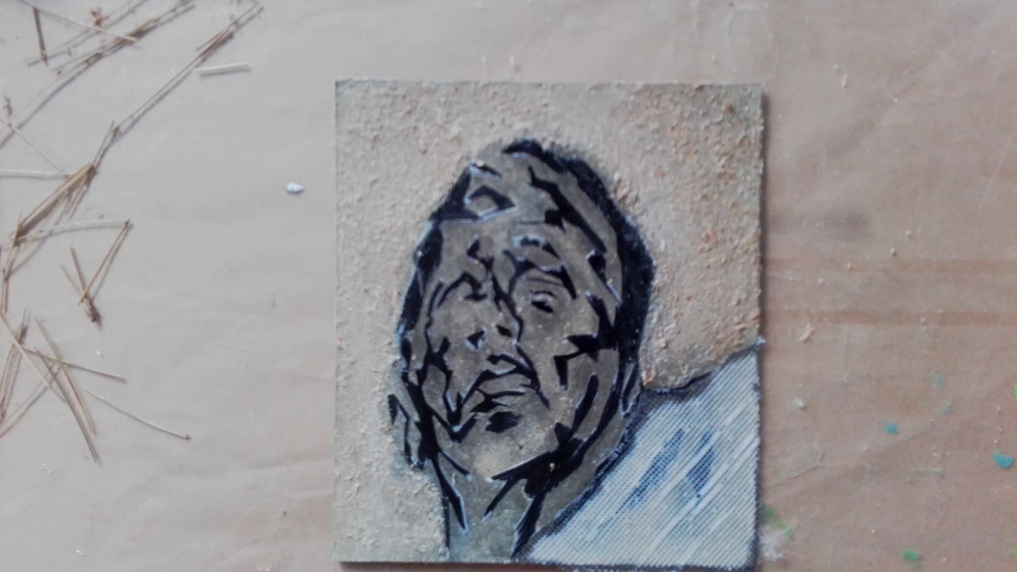
Texture for suit jacket
11: I hold the net curtain over the suit area, drawing an outline where the suit jacket is with a felt pen. I cut and glue into place.

Slide 12
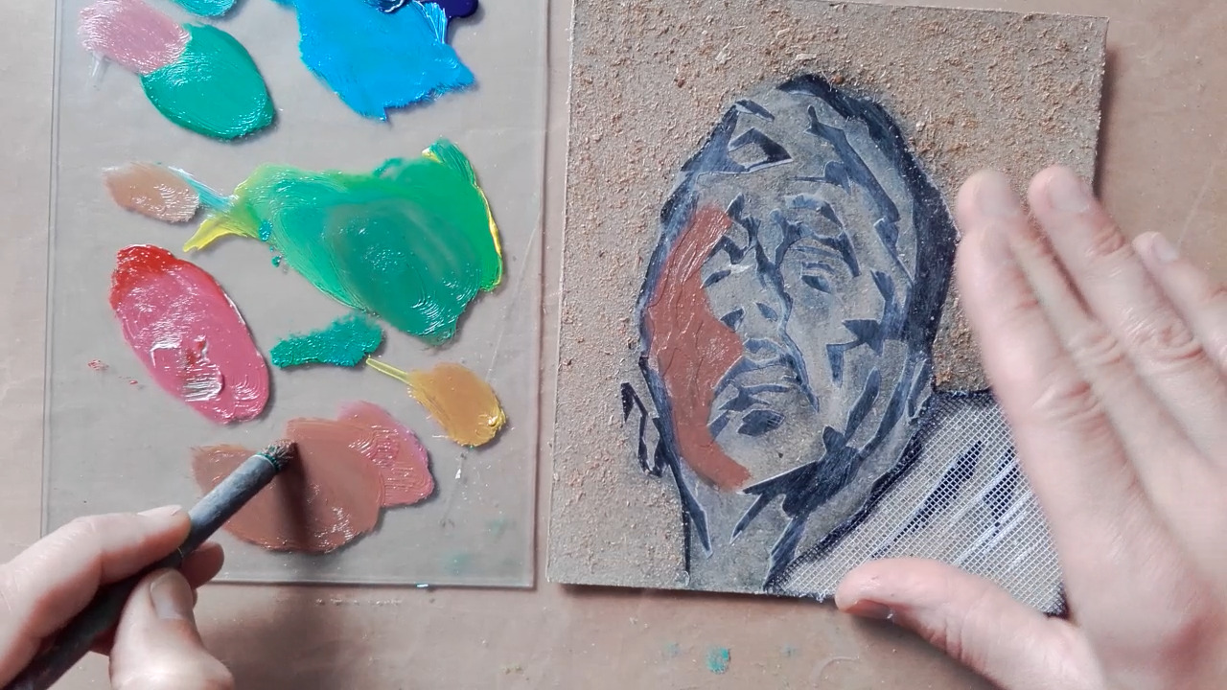
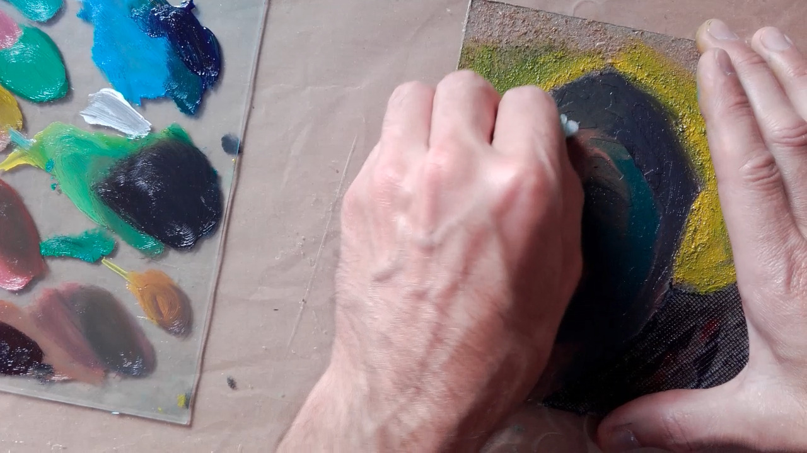
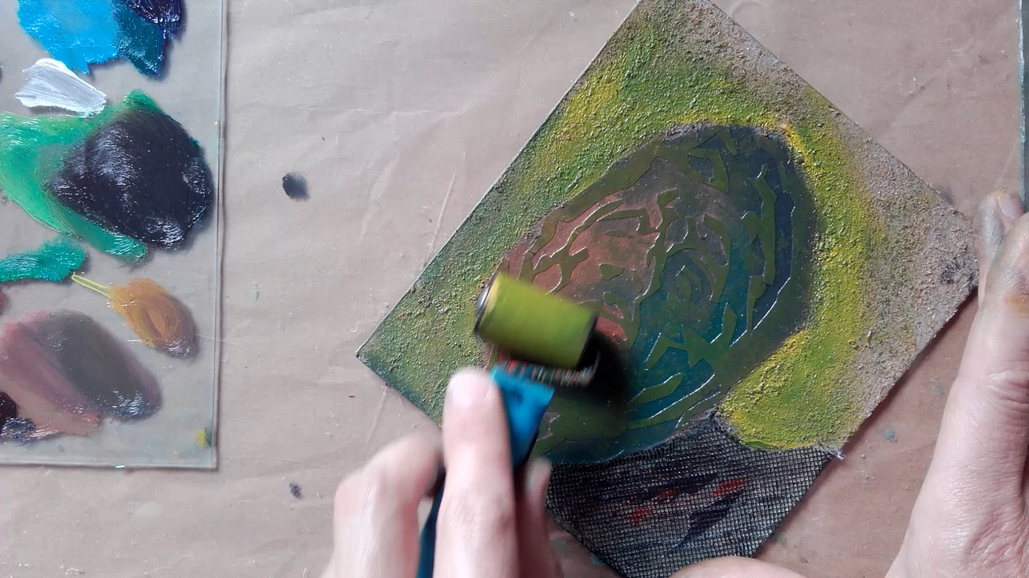
Inking for printing
12: A variety of colours are produced with printing ink. Using a stencil brush I add these inks to the printing plate.
13: Using a folded piece of cloth, I spread these colours around the plate, so they mix into one another.
14: I also use a roller to cover the raised stencil with a colour.

Slide 13
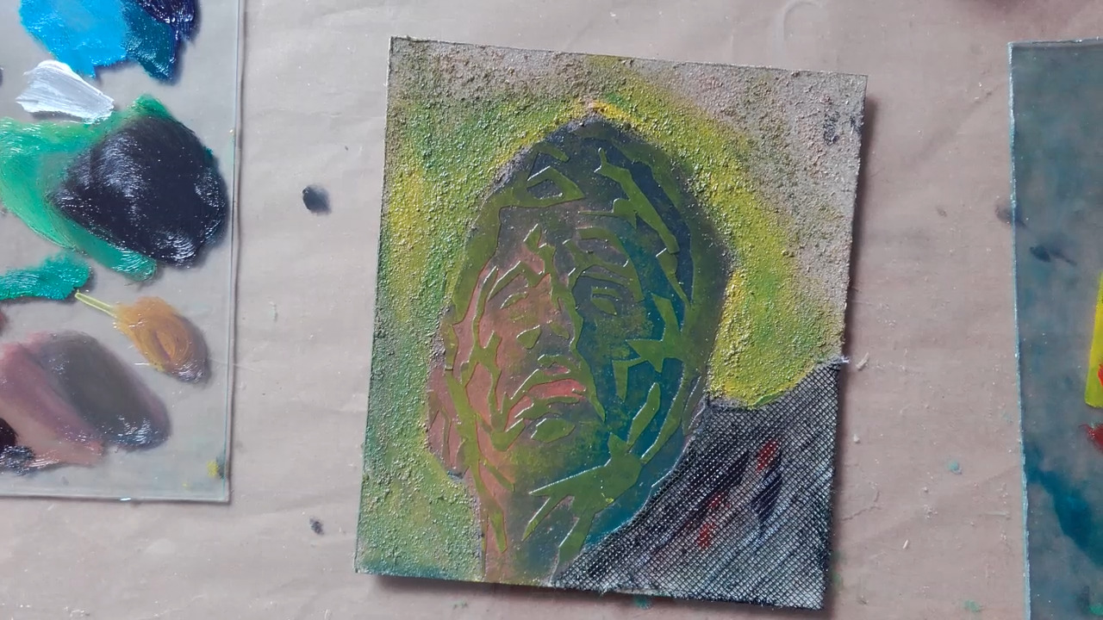
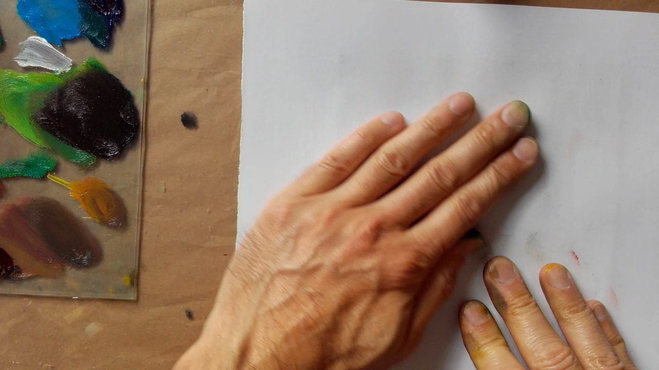
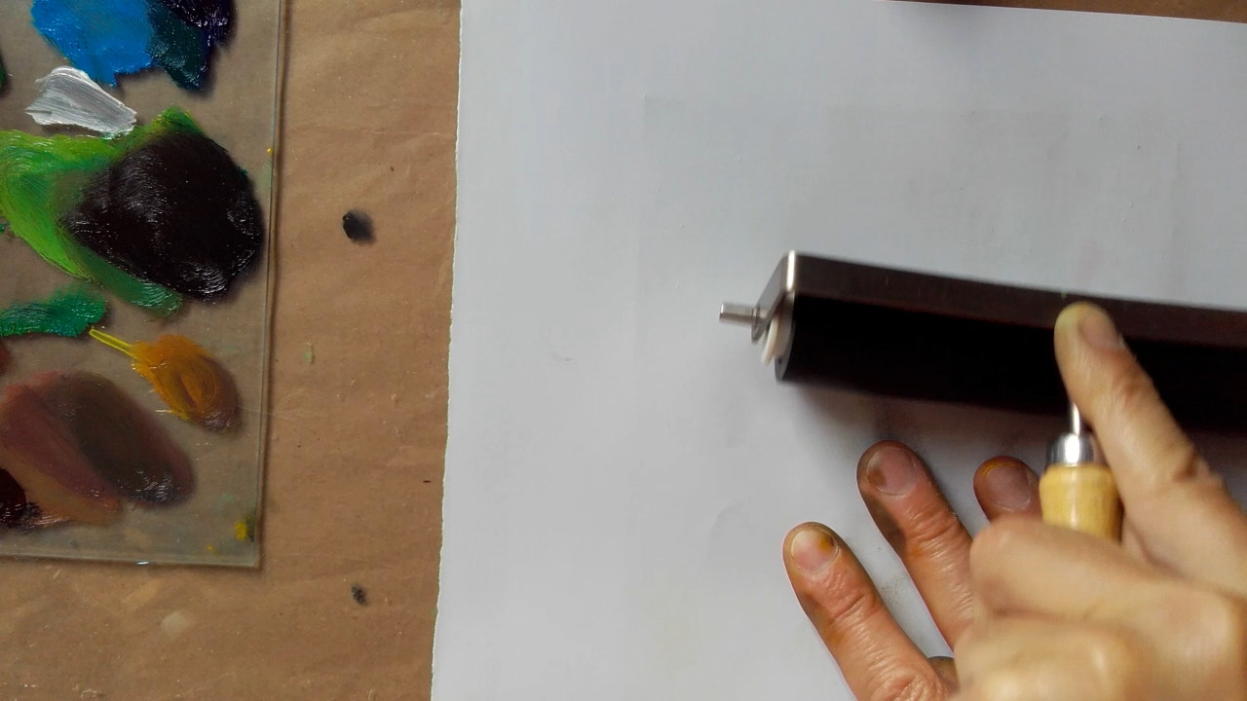
Printing
15: The inked plate is laid flat onto the table top.
16: A piece of paper is carefully placed on top.
17: I hold the paper in place, whilst using my left hand to rub the back of the paper, picking up ink from the plate.
18: I use a roller to add some additional pressure.

